Slide 1
Data collection
First Adaptive LIDAR focused Dataset. First to include Light Curtain, and 3D Eye Gaze Data with LIDAR data

Slide 2

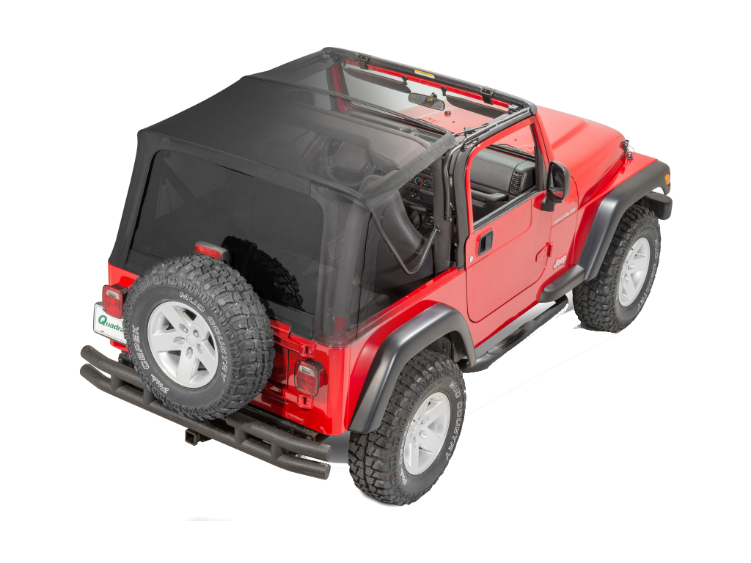


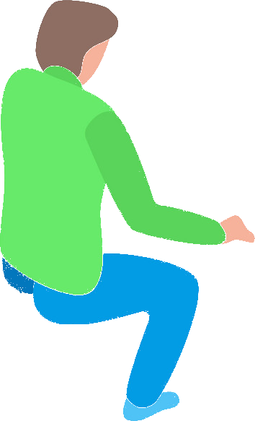
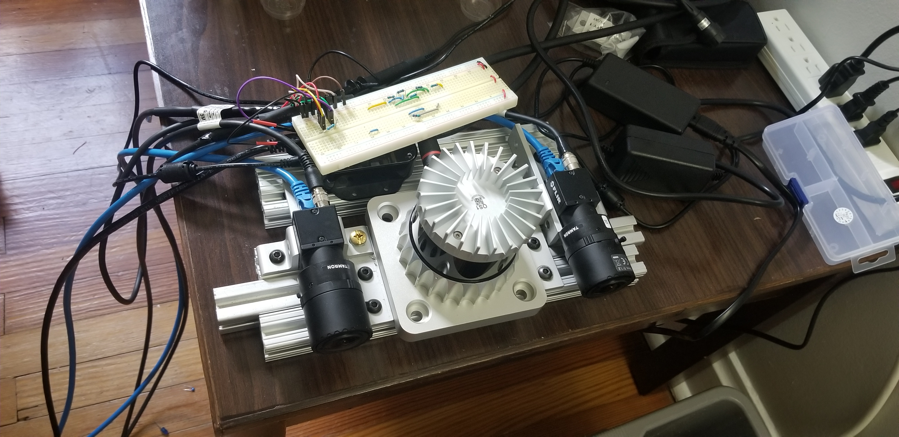
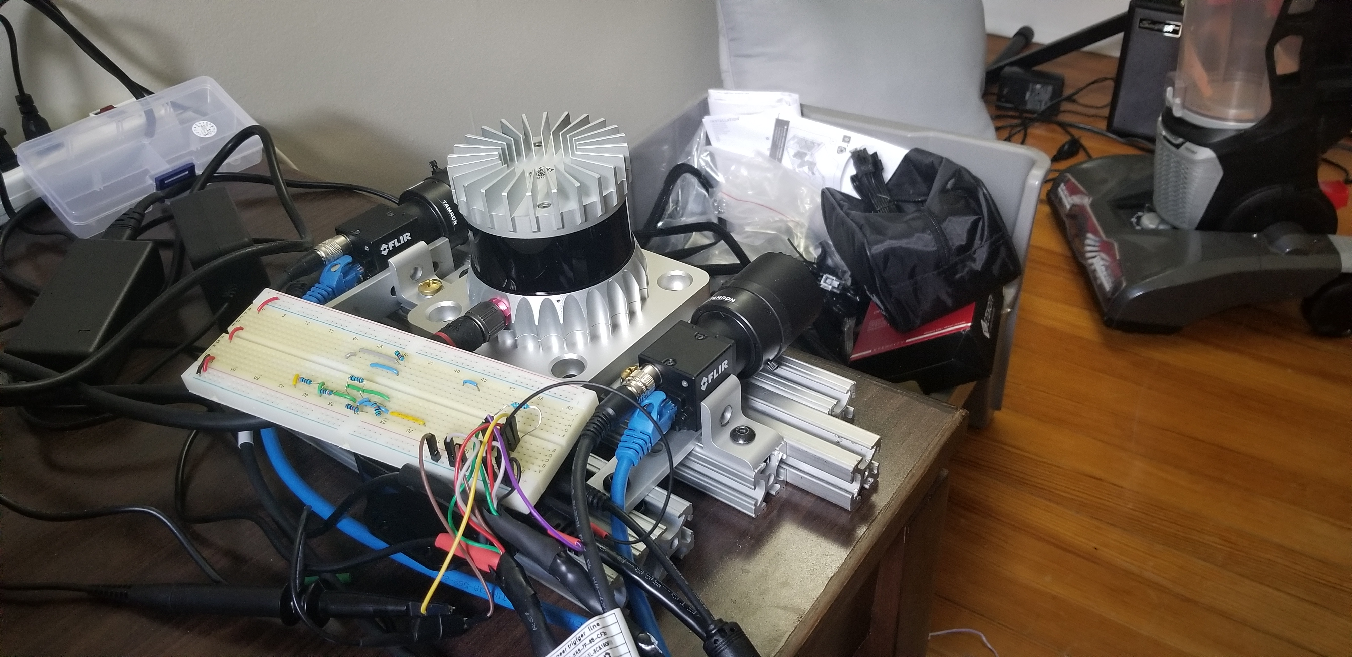

Sensor Placement
large calibration board to calibration lidar/cameras/LC
1.5deg tilt
22.5 deg FOV
left/main
cam
Os2
LC
right
cam
Os2 HW triggers the cams
tobii glasses
First car base visible at
4.5m
AR markers track
tobii head pose
Data collection PC:
Eth0: Left Cam
Eth1: Right Cam
Eth2: OS2
Eth3: Tobii
USb0: LC
Usb1: Wheel Odom
PTP Master: Eth0
PTP Slaves: OS2 only
Cameras hardware triggered by OS2
AR markers calibrated to main cam via glasses
2.0m
wheel odom
Notes:
file:///home/raaj/driver_ws/20200611_171630.jpg

Slide 3
Wiring/Frame Diagram
TTL Signal
3.3V Signal
12V
Synchronization
The Desktop acts as the PTP Grandmaster. The lidar produces a pulse that is synced to the PTP Clock, and this pulse triggers the Cameras. The Cameras and LIDAR output a timestamp to match the PTP Grandmaster.
Extrinsics
We need to get the pose of the Tobii glasses with the Camera on vehicle. To do this, we track the pose of the Tobii wrt the Aruco Marker. We can calculate the transform from Aruco1 to the LCamera via the Calibration board initially.
Calibration Board
24V
Gigabit
USB
LCamera
Lidar
RCamera
LC
Collaboration:
Talk to other labs if this data can be used for SLAM research (requires a GPS/Imu unit)?
Aruco1
Aruco2
Aruco2
Tobii
Desktop
Wheel Odom

Slide 4
Engineering Required
- Write all sensor ROS/Software drivers (1 wk)
- Setup wiring for sync/power (1 wk)
- Setup the Desktop required for data collection (1 day)
- Perform Intrinsics calibration for Left/Right cameras (1 day)
- Setup software for PTP Time Sync setup (3 day)
- Write software to run stereo camera (2 day)
- Print/Mount calibration board and Aruco Markers (1 day)
- Write software to calibrate extrinsics for LIDAR/Camera and test it (1 wk)
- Write software for Tobii Glasses/Hardware (2 day)
- Write software for Tobii headpose to be tracked by Aruco (2 day)
- Mount sensors on vehicle and integrate all hardware (1 wk)
- Setup and install the Aruco AR Markers in the vehicle (1 day)
- Test and ensure all data is recorded correctly (1 day)
- Collect the raw data needed to perform extrinsic calibration (Done for every new experiment)
- Write software to do some real time SLAM (to get car pose data) (few days)
- Integrate software to place light curtains from LIDAR data (1 day)
- Integrate software to place light curtains from Raaj's algorithm RGB only (few days)
- Develop algorithm to place light curtains from the 3D Eye Gaze Data?
Only then can we start doing data collection / Testing

Slide 5
Hardware Required
General:
General Tools / Drill etc.
80/20 Mounts and Screws
Ethernet Cables and Wires
Sensors:
Left Camera + Lens
Right Camera + Lens
Ouster OS2 Lidar
Tobii Glasses
Light Curtain Device
Calibration:
Aruco Markers + Mount
OpenCV Calibration board
Plywood/board for board
Data Recording PC:
Motherboard
CPU
PTP Network Card
Data Hard Disk 10TB
GPU
RAM
Case / Cooling
512GB SSD
750W Power Supply
Total Power Draw Expected - < 1000W

Slide 6
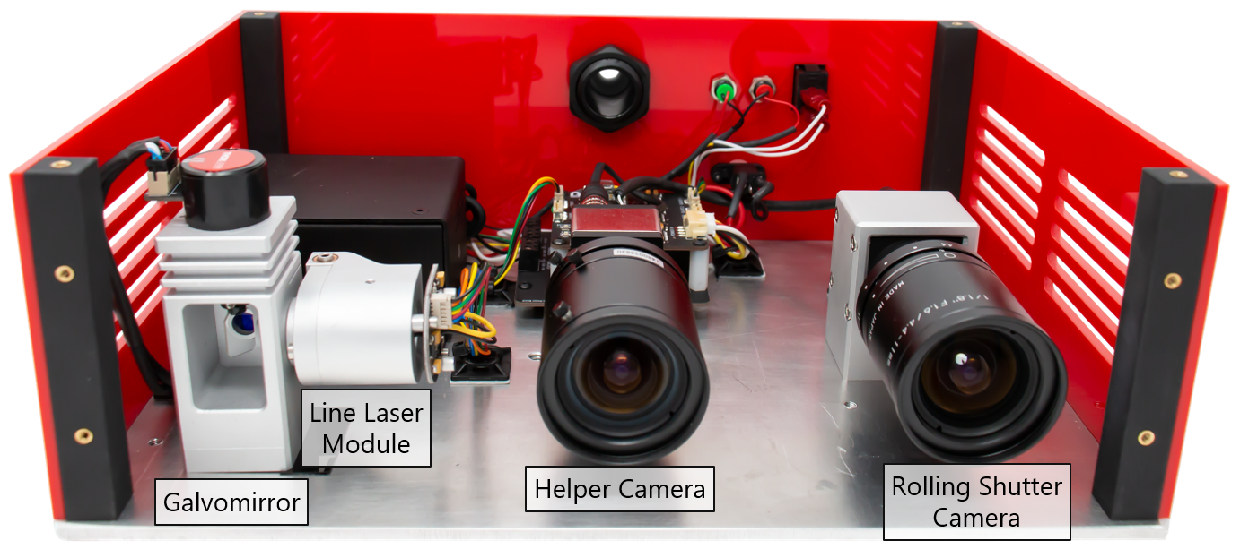
X_{i+1}
Uncertainty Region where objects that fall within this are imaged
X_{i}
X_{i-1}
Divergence
Angle
_{z}
_{z}
Thickness
_{x}
_{x}
Rolling Shutter Camera
Laser with Galvo Mirror

Slide 7
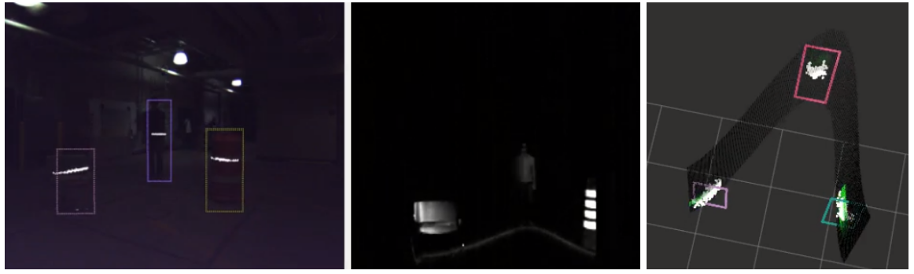
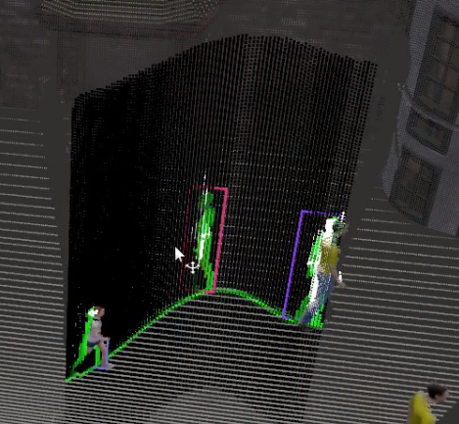
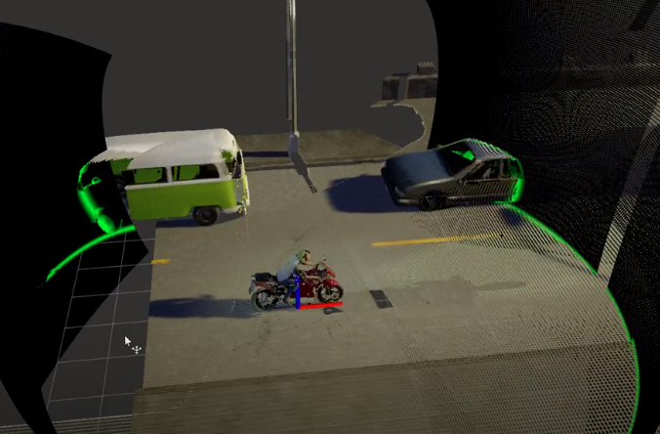

Slide 8
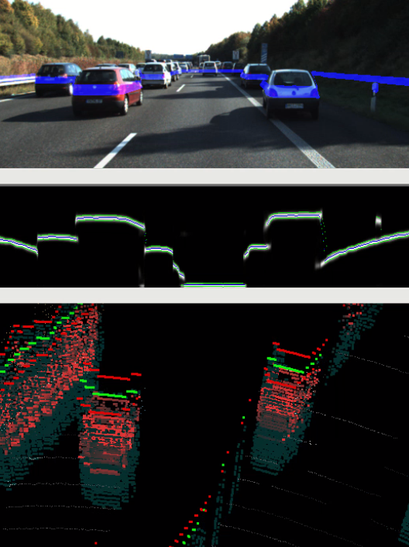
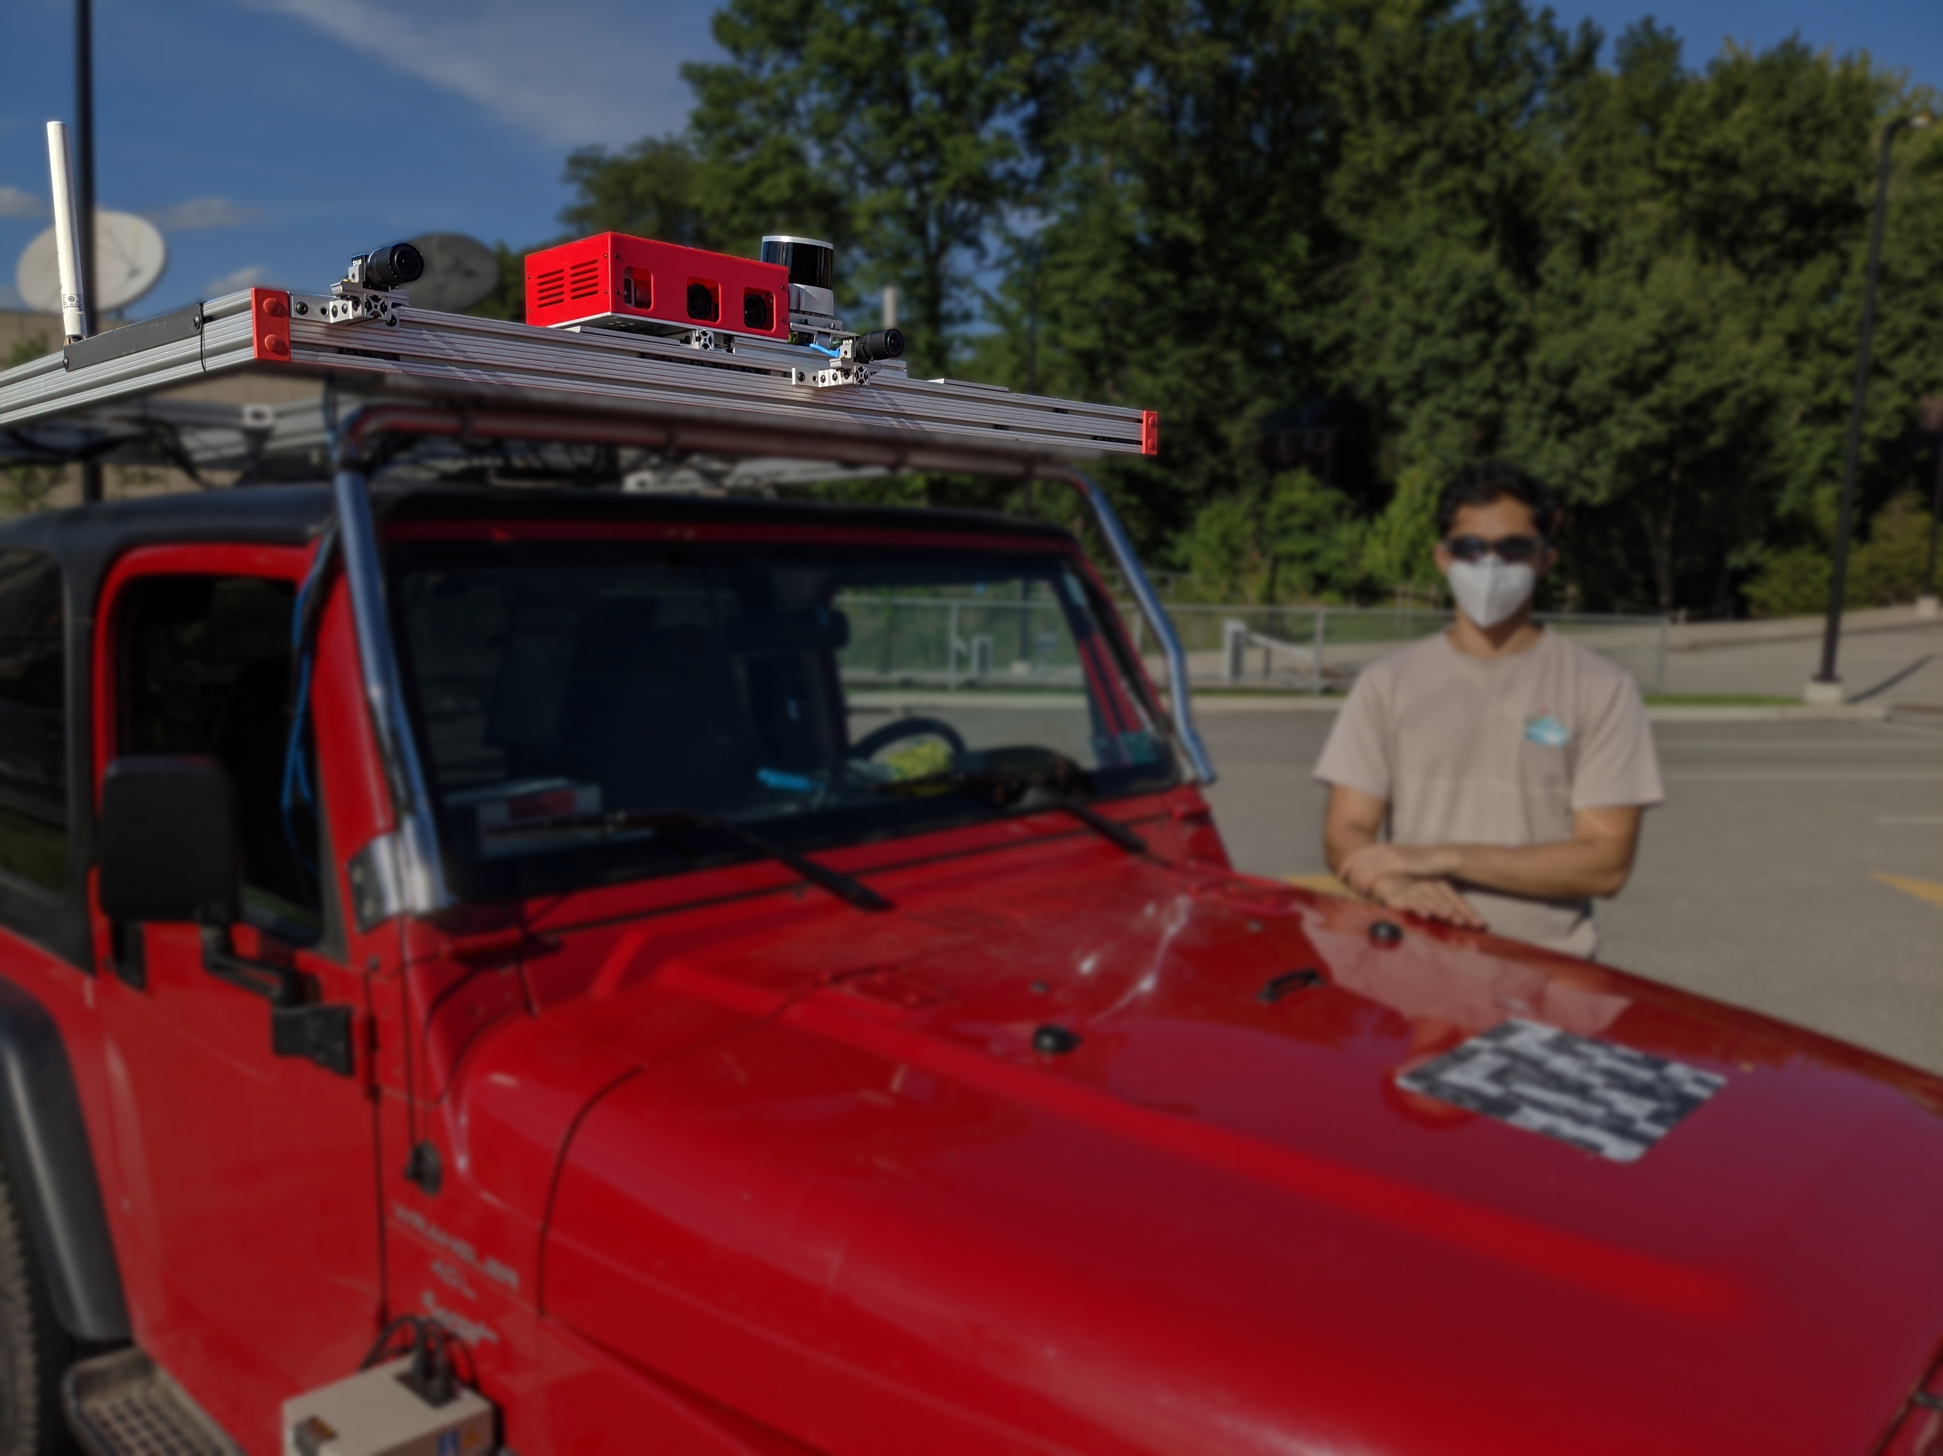
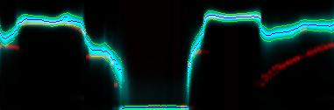
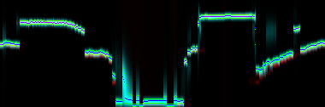
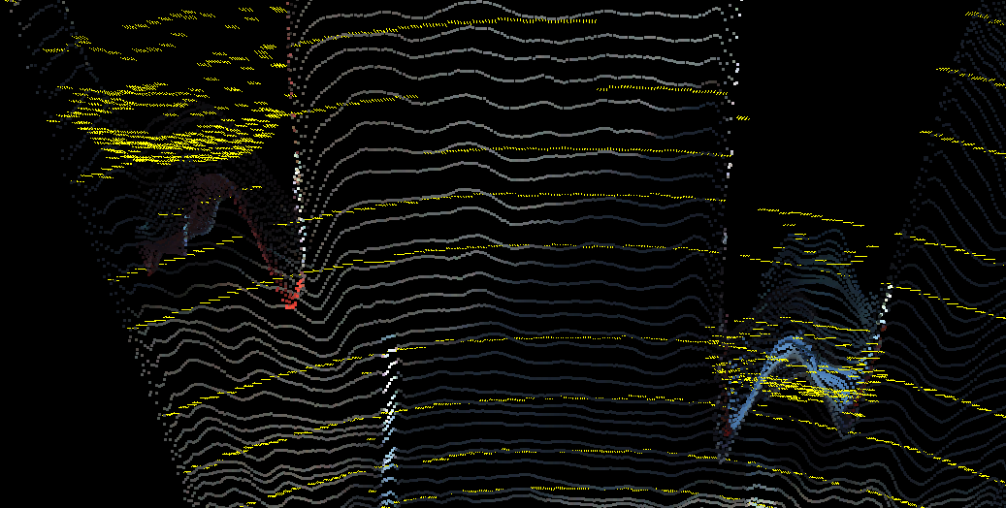
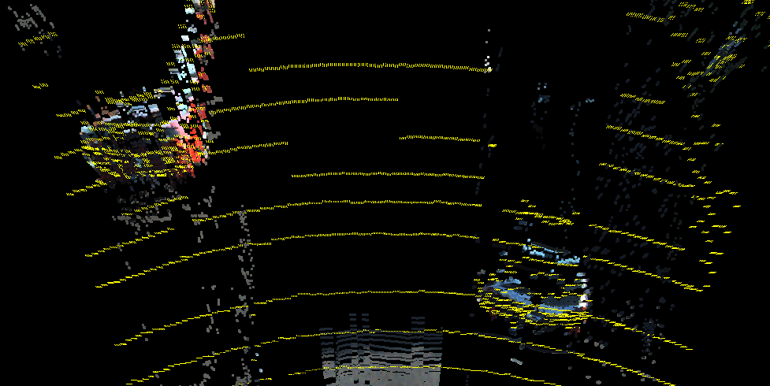
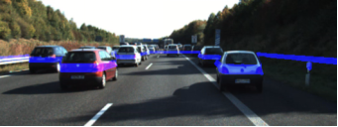
Per Pixel Depth Distribution Predicted from Monocular RGB
Used to Drive the Adaptive Light Curtain Laser
Pixel Depth corrected over Time from Light Curtain Measurements
GPS
Right
RGB
Light Curtain
Lidar
Left
RGB
Topdown Predicted Uncertainty in Blue
Lidar GT in Red
Adaptive
Laser
Line
Rolling Shutter
NIR
Seen by Driver
Lidar GT in Yellow
Expectation of Distribution produces pointcloid

Slide 9
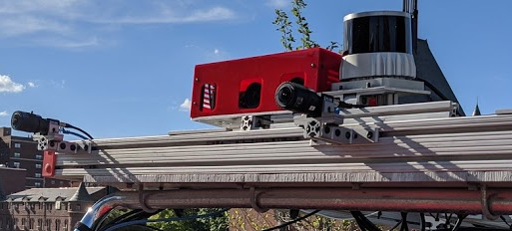
Data collection System:
Eth0: Left Cam
Eth1: Right Cam
Eth2: OS2
Eth3: Tobii
USb0: LC
Usb1: Wheel Odom
PTP Master: Eth0
PTP Slaves: OS2 only
Cameras hardware triggered by OS2
large calibration board to calibration lidar/cameras/LC
OS2-128
6 deg tilt
22.5 deg FOV
left
RGB
Light Curtain
right
RGB
Os2 HW triggers the cams
First car base visible at
4.5m
2.0m
wheel odom
Notes:
file:///home/raaj/driver_ws/20200611_171630.jpg

Slide 10

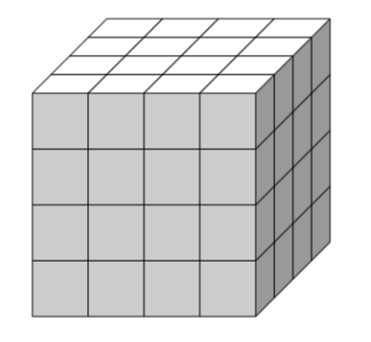
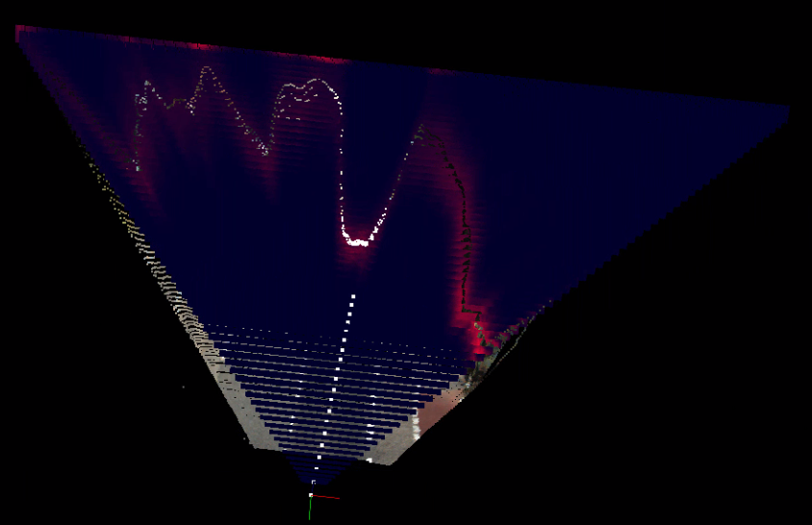
D_{candi}
z
r
D_{candi}
z
c
c

Slide 11
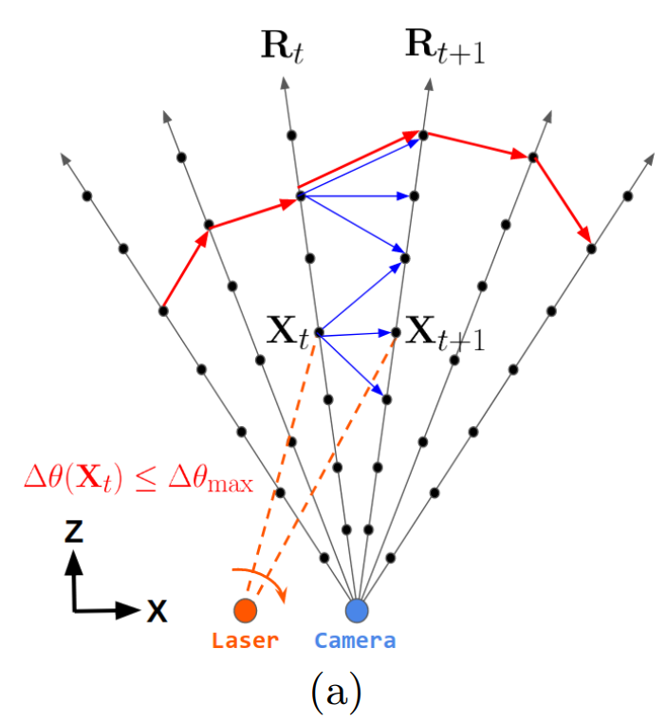
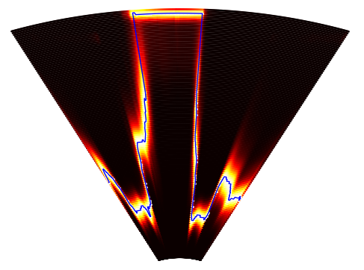
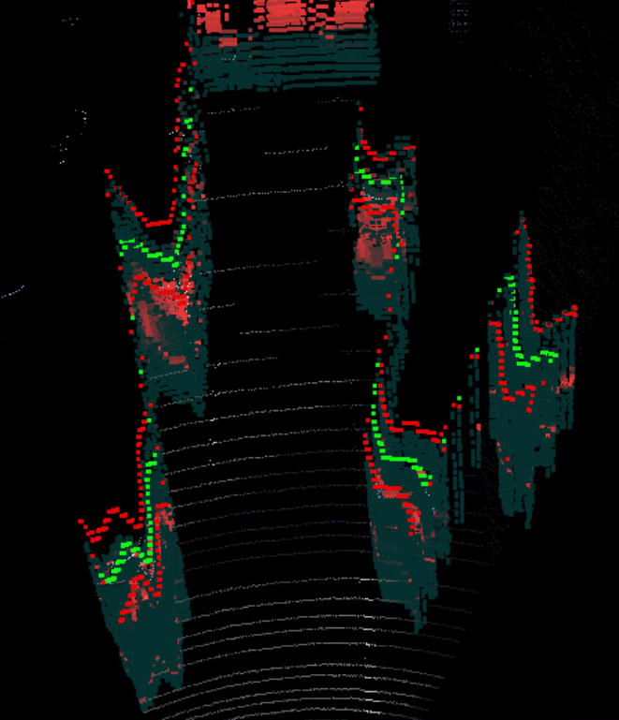
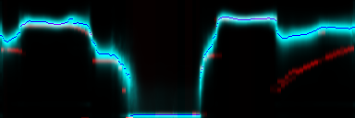
c / rays
z
range
z
z
c / rays
x

Slide 12

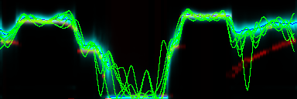
₁
m0
m0
m1
₀
z
z
z

